Slide 1
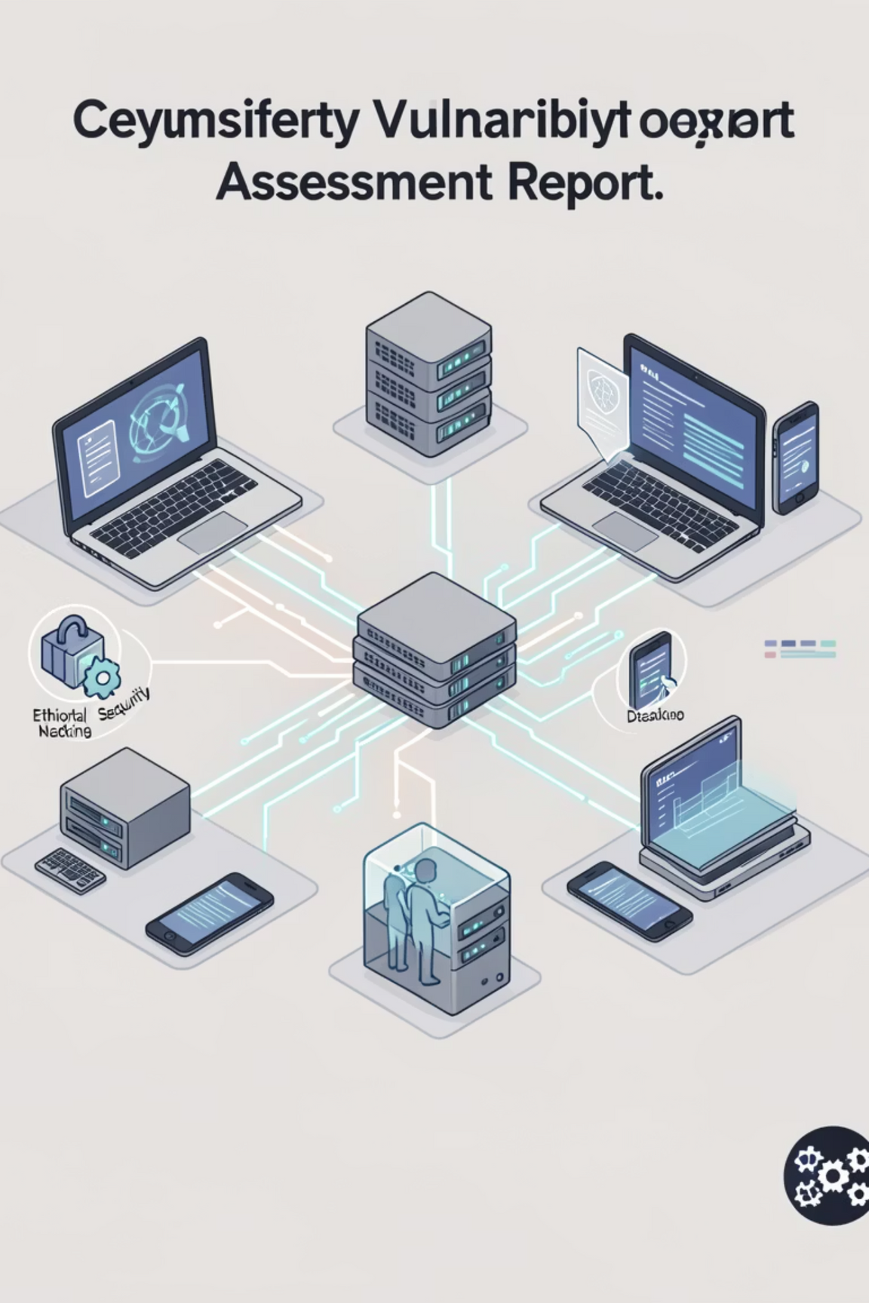
Netsparker Vulnerability Assessment Report
Submitted by: Heer Pandya
Tool Used: Netsparker
Domain: Ethical Hacking
Notes:
1

Slide 2



Objective: Unveiling Application Weaknesses
Identify Vulnerabilities
Compare Reports
To systematically identify and document security vulnerabilities within the target web application using Netsparker's automated scanning capabilities.
To perform a comprehensive comparison between Netsparker's official report and our independent analysis, ensuring thoroughness and validation.
Analyse Scan Results
To meticulously analyse the findings generated by the automated Netsparker scan, discerning patterns and critical areas of concern.
Notes:
2

Slide 3
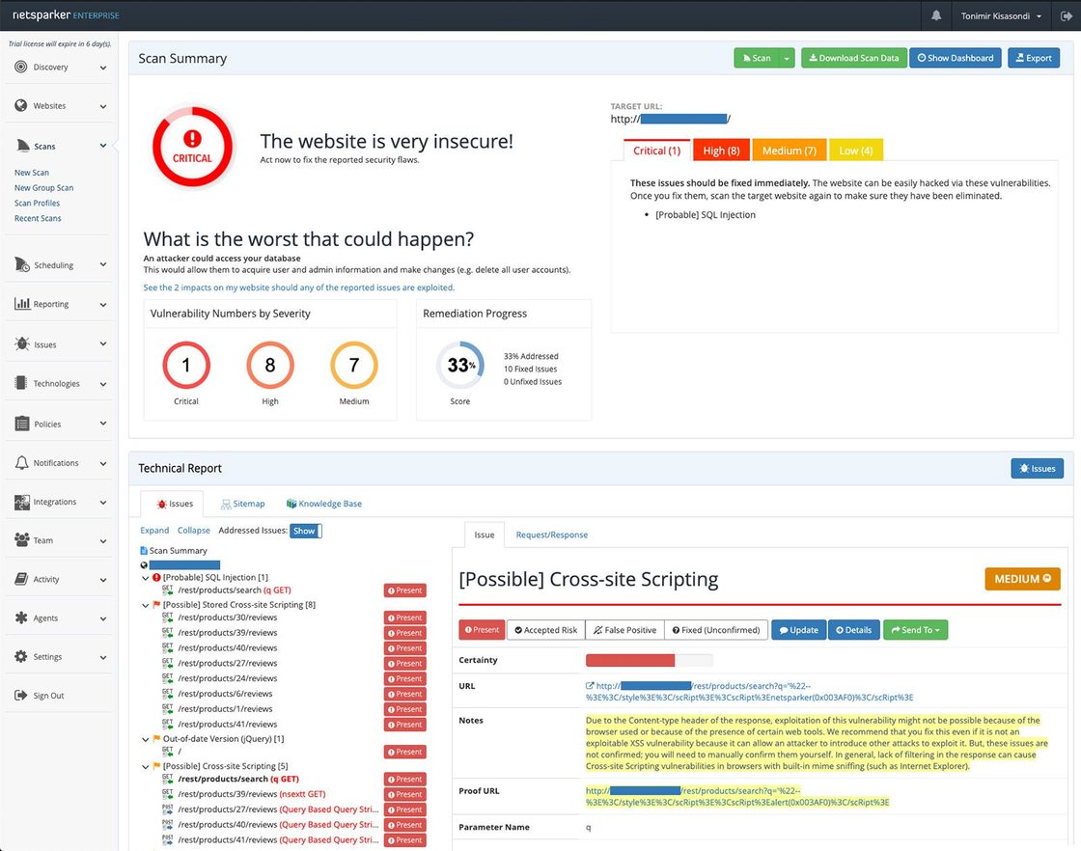
Target & Scope: Defining the Assessment Boundaries
Target Application: PortSwigger Labs
Date of Scan: 23-01-2026
Scan Mode: Authenticated
Scan Type: Automated Web Vulnerability Scan
This assessment focuses on a defined web application, utilising automated scanning techniques to identify potential security flaws. Both authenticated and unauthenticated scan modes were employed to provide a comprehensive coverage of the application's attack surface.
Notes:
3

Slide 4
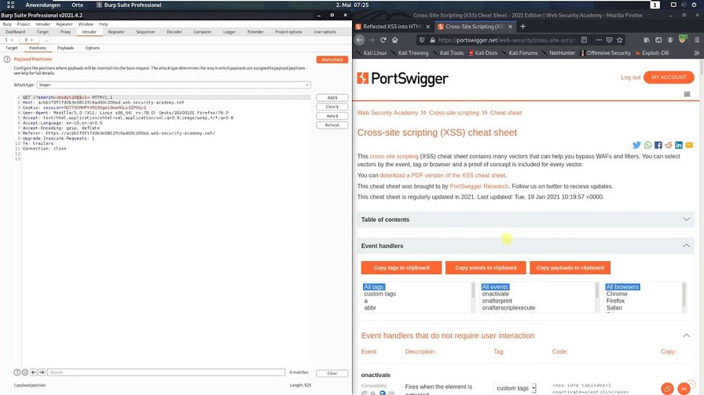
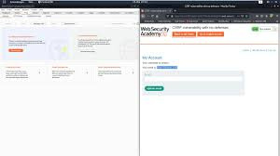
Netsparker Scan Summary: A High-Level Overview
Below is the actual vulnerability scan summary generated by Netsparker, providing an immediate snapshot of the application's security posture.
The dashboard summary highlights the total count of identified vulnerabilities, categorised by their severity levels. This initial overview is crucial for prioritising remediation efforts and understanding the overall risk landscape.
Notes:
4

Slide 5
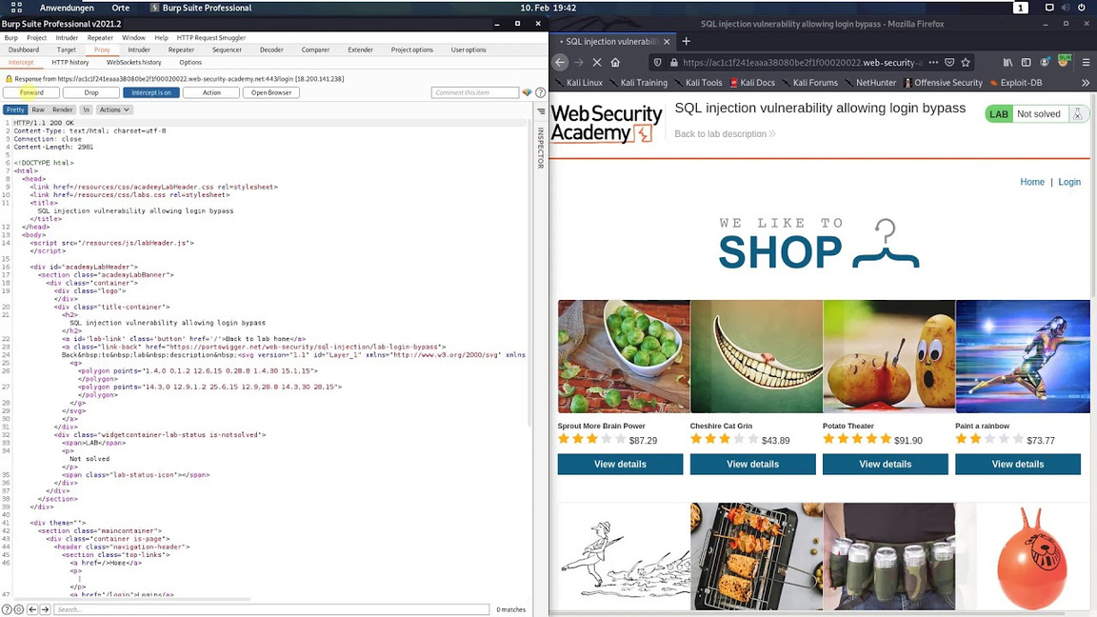

Critical Vulnerabilities: Immediate Threats Identified
Netsparker's in-depth analysis revealed several critical vulnerabilities that pose significant risks to the application's integrity and data confidentiality. These issues demand immediate attention due to their potential for severe impact.
Examples of critical findings include SQL Injection, Remote Code Execution (RCE), and authentication bypass flaws. Such vulnerabilities could lead to unauthorised access, data manipulation, or complete system compromise if left unaddressed.
Notes:
5

Slide 6
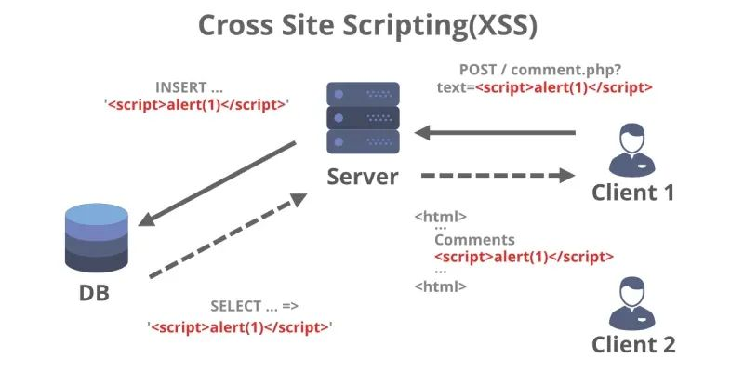
High Severity Vulnerabilities: Significant Security Gaps
Beyond critical findings, Netsparker also detected a range of high-risk vulnerabilities that, while not immediately catastrophic, present significant security gaps. These require prompt remediation to prevent potential exploitation.
Among these are Cross-Site Scripting (XSS), sensitive data exposure, and broken authentication mechanisms. Exploitation of these vulnerabilities could lead to session hijacking, data breaches, or impersonation of legitimate users.
Notes:
6

Slide 7
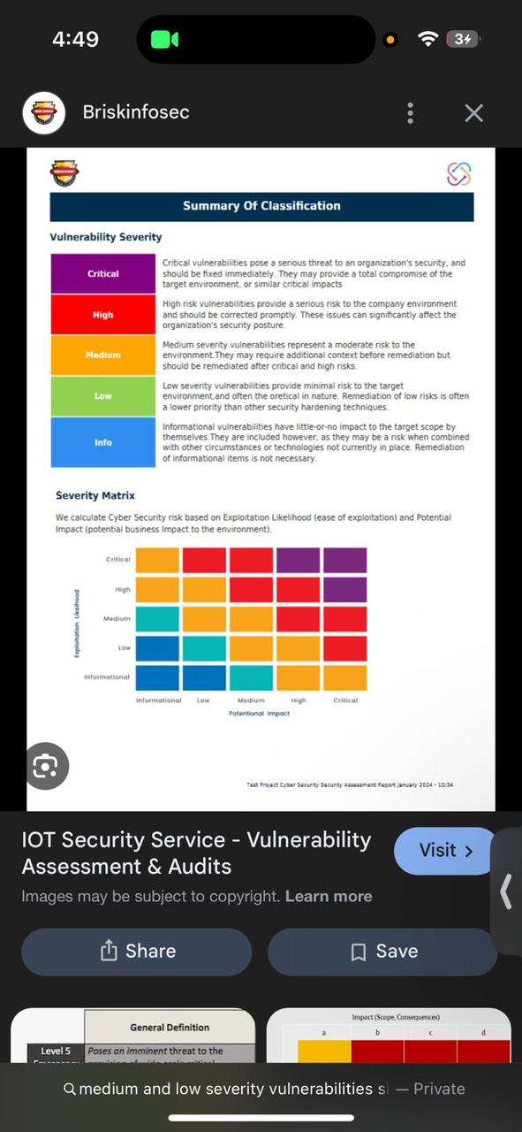

Medium & Low Vulnerabilities: Enhancing Application Hardening
Medium and low severity vulnerabilities, whilst less immediately threatening, play a crucial role in overall application hardening. Addressing these helps to reduce the attack surface and improve the resilience against more sophisticated attacks.
Common examples include missing security headers, information disclosure issues, and the absence of secure cookie flags. Rectifying these seemingly minor flaws can significantly enhance the application's resistance to various web-based attacks.
Notes:
7

Slide 8

My Written Analysis: Interpreting the Findings
Automated Verification
Severity and Impact Analysis
Exploitation Possibility
Netsparker's unique strength lies in its ability to automatically verify identified vulnerabilities, thereby significantly reducing false positives and ensuring a higher degree of confidence in the reported issues.
Each reported vulnerability was meticulously analysed, taking into account its severity level and potential impact on the application's functionality, data, and user trust. This prioritisation is key for effective remediation.
The actual possibility of exploiting a vulnerability is heavily dependent on the specific configuration and environment of the application. Therefore, practical exploitability was also considered in the assessment.
Notes:
8

Slide 9
Comparison: Netsparker Report vs. My Analysis
A direct comparison between the automated Netsparker report and my independent analysis reveals nuances in detection, accuracy, and severity assignment.
Aspect
Netsparker Report
My Analysis
Detection
Automated scanning, comprehensive coverage.
Manual explanation, focusing on context and implications.
Accuracy
Tool-verified, low false positive rate due to proof-of-exploit.
Interpreted based on application context and known attack vectors.
Severity
Tool-assigned based on predefined risk metrics.
Risk-based, considering business impact and likelihood of exploitation.
Notes:
9

Slide 10




Conclusion & Recommendations: Path Forward
Immediate Fixes for Critical & High Vulnerabilities
Prioritise and immediately remediate all critical and high severity vulnerabilities to mitigate the most pressing risks.
Implement Regular Security Scans
Establish a routine schedule for security scans to continuously monitor for new vulnerabilities and changes in the application's security posture.
Adopt Secure Coding Practices
Integrate secure coding principles and training into the development lifecycle to prevent the introduction of new vulnerabilities.
Notes:
10

